Slide 1
Activity in the Cusp
By RJ Aylward
Special Thanks to Dr. Brian Walsh and Dr. David Sibeck

Slide 2
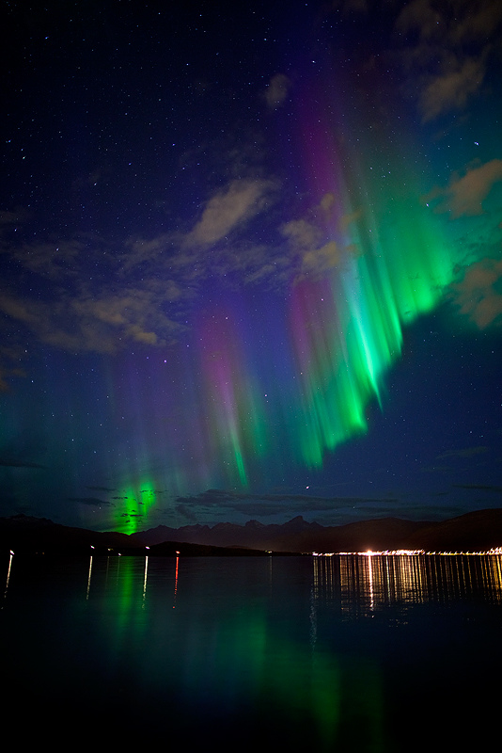
Task
To find connections between ground based measurements and satellite measurements of particles in the cusp region.
Looked at data from December and January for 1996 – 1998 (Polar) and 2001 – 2005 (Cluster) using cdaweb plots and idl

Slide 3
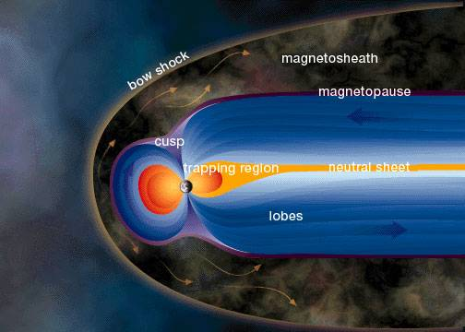
Magnetosphere

Slide 4
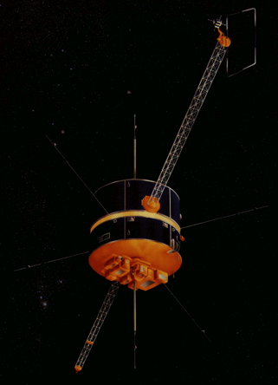
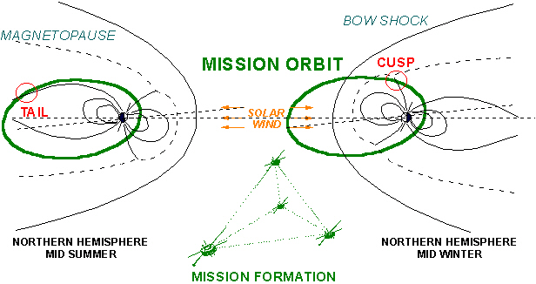
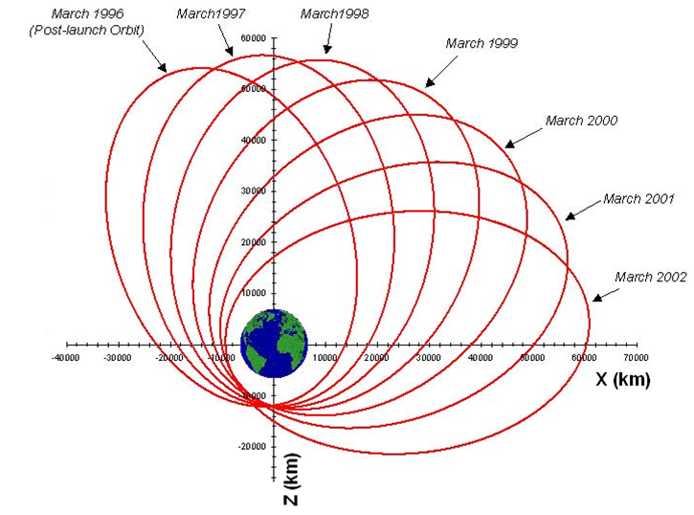
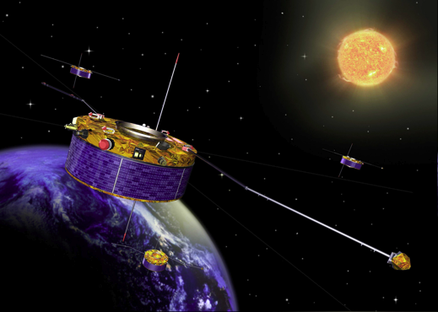
Cluster and Polar Missions

Slide 5
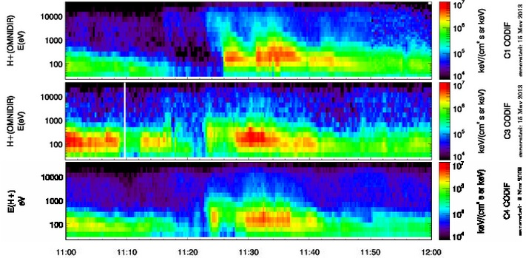
Cluster Data
Instrument used was the CIS experiment
X axis shows time in UT
Y axis shows ion energy in eV
Color bar shows ion flux

Slide 6
Reconnection

Slide 7
Reconnection

Slide 11
Energy
Time

Slide 12
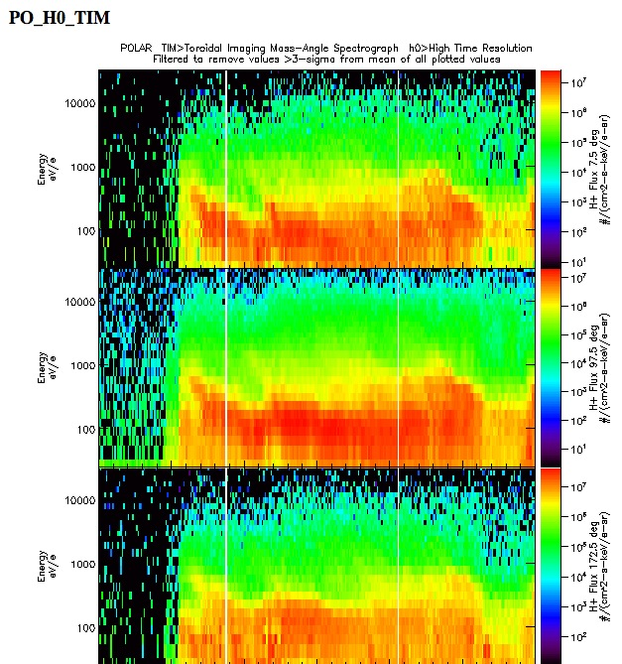
Polar Data
Looked for similarly shaped dispersions
Also check the magnetic field data to find points where it was at a minimum
Three sections to the detector

Slide 13
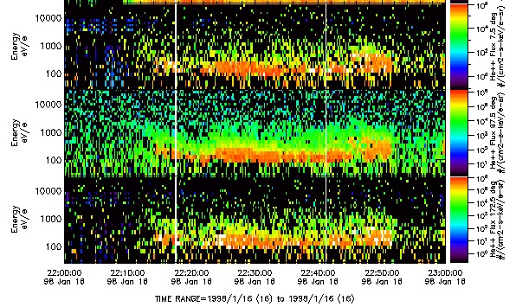
Is it really in the Cusp?
# of He⁺⁺
Cusp Region
Density of He⁺⁺ ions
The sun has enough energy to break 2 electrons off He
He atoms near Earth can be photoionized but there is only enough energy to make He⁺

Slide 14
He⁺⁺
He⁺⁺
He⁺
He⁺
He⁺⁺

Slide 15
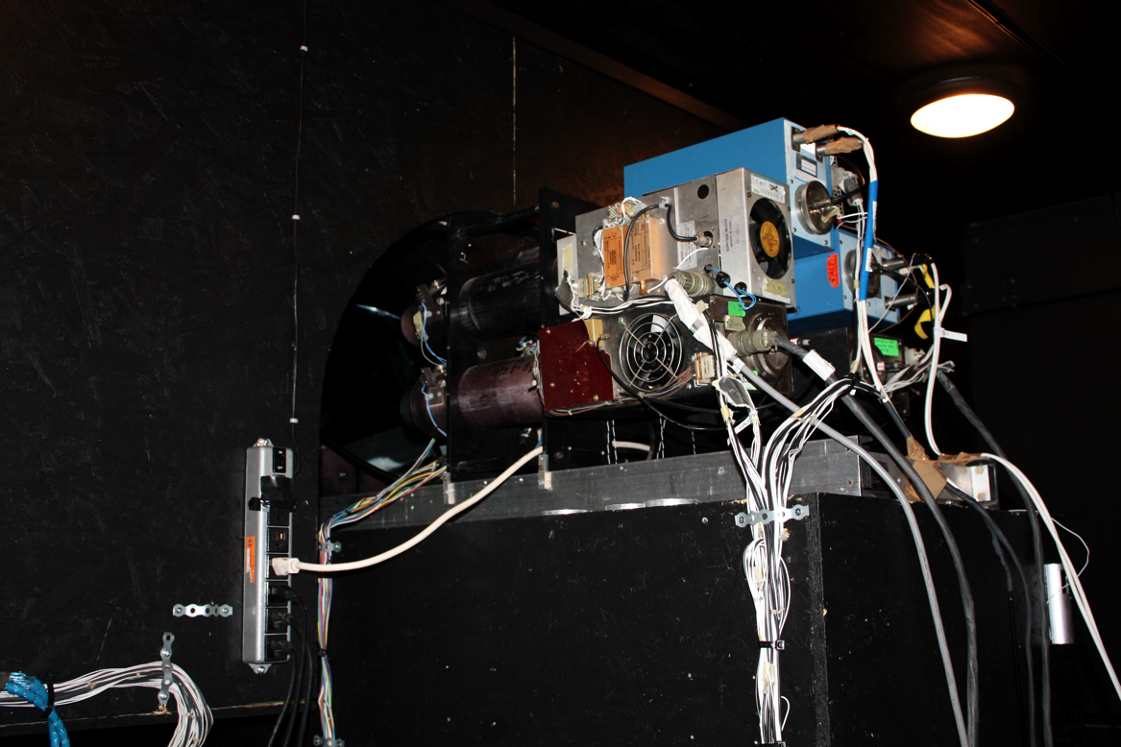
Meridian Scanning Photometer

Slide 16
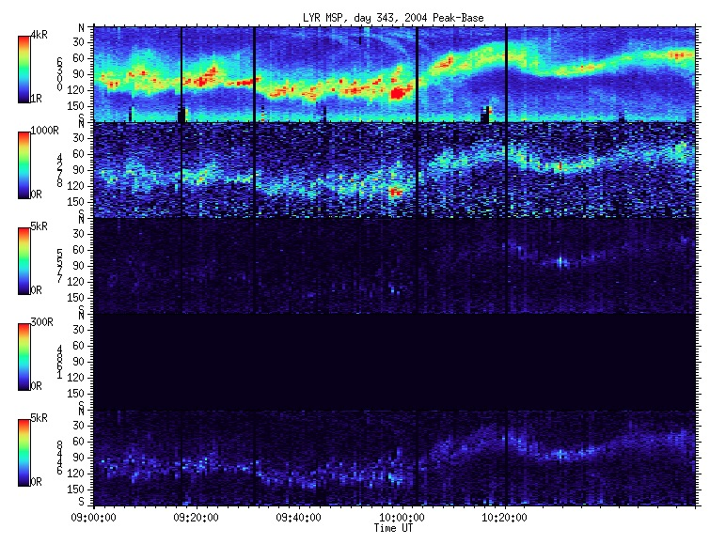
MSP Data - PMAF

Slide 19
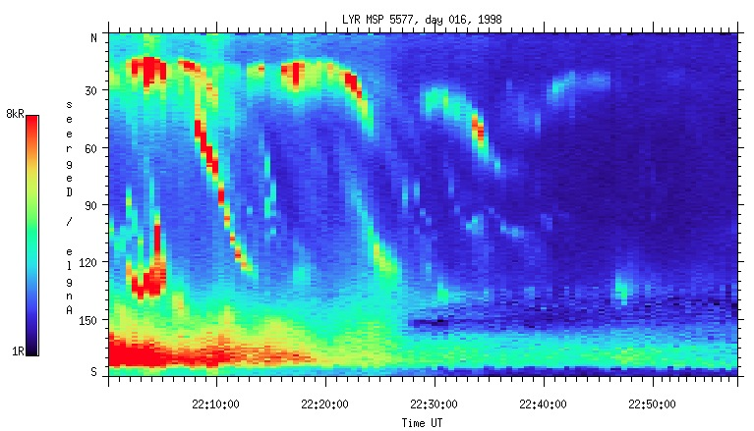
MSP Data EMAF

Slide 20
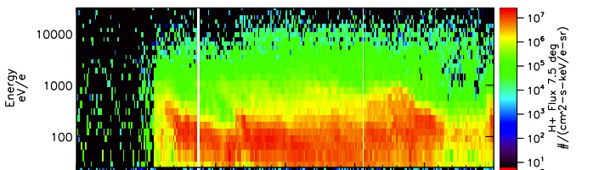
Direct comparison

Slide 21
Predominantly Northward IMF

Slide 26
Reconnection occurs in the lobe region

Slide 32
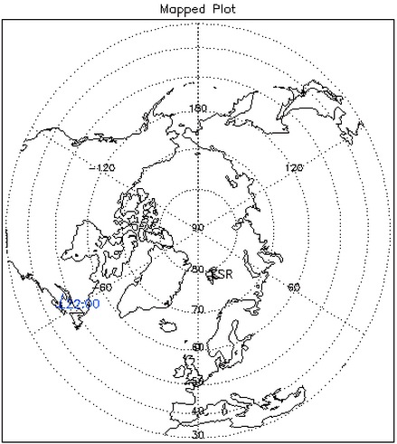
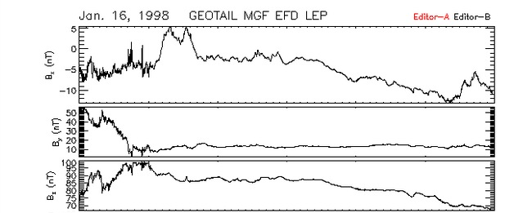

GeoTail IMF Data

Slide 33
Direct comparison

Slide 34
Future Research
Look for more data documenting what is happening on this day.
The more view we can find the clearer picture why the data is showing conflicting sources of reconnection
We would like to find out if something more exotic is going on for this particular day.

Slide 35
What I Learned…
Going through data takes a lot longer than I felt like it should.
You have to be patient and go through a lot of data if you want to find something interesting
I was encouraged to research and learn as much as I could about the detectors on the satellites and ground stations that was using in order to help further my understanding of the data. This was extremely beneficial.
Learned a little bit of programing and have been heavily encouraged to learn more going forward.

